Slide 1

RAJESHWARI VEDHACHALAM GOVT ARTS COLLEGE
BACHELOR OF COMPUTER APPLICATION

Slide 2

EARLY PREDICTION FOR CHRONIC KIDNEY DISEASE DETECTION A PROGRESSIVE APPROACH TO HEALTH MANAGEMENT
PRESENTED BY
HARIHARAN
THAMIZHSHARMA
SURIYA
VIGNESH

Slide 3
INTRODUCTION
WE CREATE A MACHINE LEARNING PROGRAM TO IDENTIFY THE PRORGAM OF CHRONIC KIDNEY DISEASE(CKD)
CKD IS A MAJOR MEDICAL PROBLEM AND CAN BE CURED IF TREATED IN THE EARLY STAGES
PURPOSE OF THE PROJECT
THAT WE PREDICT THE PROBLEM IN SHORT TIME SO WE SAVE THE PATIENT LIVE FROM RISK

Slide 4
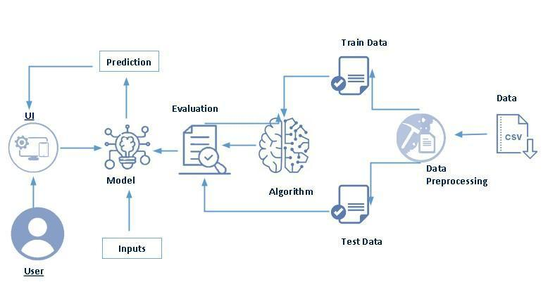
TECHNICAL ARCHITECTURE
THIS DIAGRAM REPRESENT THE PROJECT FLOW OF THE CHRONIC KIDNEY DISEASE

Slide 5
PROBLEM STUDIES
CHRONIC KIDNEY DISEASE(CKD) IS A MAJOR MEDICAL PROBLEM AND CAN BE CURED IF TREATED IN THE EARLY STAGES
SYMPTOMS
CONTINIOUS URINE PROBLEM
SMALLER KIDNEY SIZE

Slide 6
TYPES OF KIDNEY DISEASE
DIABETES
BP(BLOOD PRESSURE)
PALYSISTIC KIDNEY DISEASE
GLOMERULONEPHRETS
DATA COLLECTION & PREPARATION
TO COLLECT MANY PATIENT CASE DETIALES ABOUT THE DEASISE IN VARIOUS HOSPITALS AND USE IT FOR SOFTWARE DEVELOPEMENT

Slide 7
SEARCH FOR SIMILAR SOFTWARS AND TAKE THE BETTER INVENTED IDEAS IN THE SOFTWARE AND USE & UPGRADE IT
GIVE A FULL THEORITICAL INFORMATION TO THE PATIENT TO GET A IDEA ABOUT THE DIALISIS
ADD ADDITIONAL FEATURES IN THE SOFTWARE LIKE WHAT THEY DO AND WHAT THEY DON'T DO BEFORE AND AFTER DIALISIS

Slide 8
MODULE BUILDING
TRAINING THE MODEL IN MULTIPLE ALGORITHM
ANN MODEL
RANDOM FOREST MODEL
DECISION TREE MODEL
LOGISTIC REGRESSION
TESTING THE MODEL

Slide 9
BENIFITES OF CKD MECHINE LEARNING
IT IS THE MOST ADVANCED AI MODEL TO IDENTIFY THE KIDNEY PROBLEMS
IT IS MORE HELP TO AVOID PATIENTS RISK ZONE FROM THE DISEASE
IT GUIDE THE PATIENTS AND DOCTORS TO COMPLETELY RECTIFY THE PROBLEM OF CKD

Slide 10
THANK YOU

